Slide 1
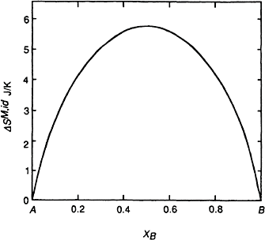

266 Introduction to the Thermodynamics of Materials
Figure 9.7 The variation, with composition, of the molar entropy of formation of a binary Raoultian solution.
9.7 NONIDEAL SOLUTIONS
A nonideal solution is one in which the activities of the components are not equal to their mole fractions. However, in view of the convenience of the concept of activity and the simplicity of Raoult’s law, it is convenient to define an additional thermodynamic function called the activity coefficient, μ. The activity coefficient of a component of a solution is defined as the ratio of the activity of the component to its mole fraction, i.e., for the component i,
(9.46)
The value of μ_{i} can be greater or less than unity (μ_{i}=1 gives ideal Raoultian behavior). If μ_{i}>1, then the component i is said to exhibit a positive deviation from Raoultian ideal behavior, and, if μ_{i}<1, then the component i is said to exhibit a negative deviation from Raoult’s law. Fig. 9.8 shows the variation of a, with X_{i} for a component i which exhibits
negative deviations, and Fig. 9.9 shows a system which exhibits positive deviations. The corresponding variations of μ_{i} are shown in Figs. 9.10 and 9.11.

Slide 2

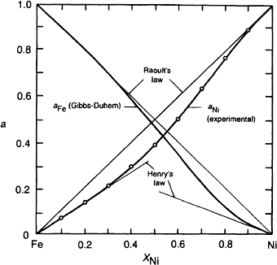
The Behavior of Solutions 267
If μ_{i} varies with temperature, then
has a nonzero value, i.e., from Eq. (9.41)
Figure 9.8 Activities in the system iron-nickel at 1600°C. (From G.R.Zellars, S.L.Payne, J.P.Morris, and R.L.Kipp, “The Ac- tivities of Iron and Nickel in Liquid Fe-Ni Alloys,” Trans. AIME (1959), vol. 215, p. 181.)

Slide 3
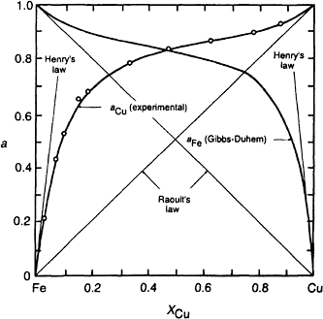
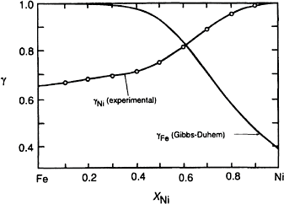
268 Introduction to the Thermodynamics of Materials
Figure 9.9 Activities in the system iron-copper at 1550°C. (From J.P.Morris and G.R.Zellars, “Vapor Pressure of Liquid Cop- per and Activities in Liquid Fe-Cu Alloys,” Trans. AIME (1956), vol. 206, p. 1086.)
Figure 9.10 Activity coefficients in the system iron-nickel at 1600°C.

Slide 4
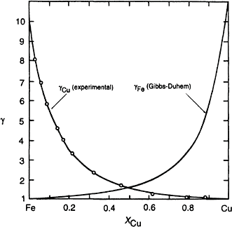



The Behavior of Solutions 269
Figure 9.11 Activity coefficients in the system iron-copper at 1550°C.
and
Thus
and as
then
(9.47)

Slide 5
270 Introduction to the Thermodynamics of Materials
In general, increasing the temperature of a nonideal solutions causes a decrease in the extent to which its components deviate from ideal behavior, i.e., if μ_{i}>1 then an increase
in temperature causes μ_{i} to decrease toward unity, and if μ_{i}<1 an increase in temperature causes μ_{i} to increase toward unity. Thus in a solution, the components of which exhibit
positive deviations from ideality, the values of the activity coefficients decrease with increasing temperature, and hence, from Eq. (9.47), the partial molar heats of solution of
the components are positive quantities. Thus OH^{M}, the molar heat of formation of the solution is a positive quantity, which indicates that the mixing process is endothermic.
OH^{M} is the quantity of heat absorbed from the thermostatting heat reservoir surrounding the solution per mole of solution formed at the temperature T. Conversely, in a solution, the components of which exhibit negative deviations from ideality, the activity coefficients increase with increasing temperature, and hence, the partial molar heats of mixing and the molar heat of mixing are negative. Such a solution forms exothermically,
and OH^{M} is the heat absorbed by the thermostatting heat reservoir, per mole of solution formed, at the temperature T.
Exothermic mixing in an A–B binary system occurs when the A–B bond energy is more negative than both the A–A and B–B bond energies, and this causes a tendency toward “ordering” in the solution, in which the A atoms attempt to only have B atoms as nearest neighbors and vice versa. Exothermic mixing thus indicates a tendency toward the formation of a compound between the two components. Conversely, endothermic mixing occurs when the A–B bond energy is less negative than both the A–A and B–B bond energies, and this causes a tendency toward phase separation or “clustering” in the solution. The A atoms attempt to be coordinated only by A atoms, and the B atoms attempt to be coordinated only by B atoms. In both cases the equilibrium configuration of the solution is reached as a compromise between the enthalpy factors, which, being determined by the relative magnitudes of the bond energies, attempt to either completely order or completely unmix the solution, and the entropy factor which attempts to maximize the randomness of mixing of the atoms in the solution.
9.8 APPLICATION OF THE GIBBS-DUHEM RELATION TO THE DETERMINATION OF ACTIVITY
As was stated in Sec. 9.4, it is often found that the activity of only one component of a binary solution can be measured experimentally. In such cases the variation of the activity of the other component can be obtained from an application of the Gibbs-Duhem equation, Eq. (9.20),

Slide 6


The Behavior of Solutions 271
Applied to a binary A–B solution and using Gibbs free energy as the extensive property,
Eq. (9.20) becomes
(9.48)
and, as ln a_{i}, then
(9.49)
or
(9.50)
If the variation of a_{B} with composition is known, then integration of Eq. (9.50) from
X_{A}=1 to X_{A} gives the value of log a_{A} at X_{A} as
(9.51)
As an analytical expression for the variation of the activity of B is not usually computed, Eq. (9.51) is solved by graphical integration.
Fig. 9.12 shows a typical variation of log a_{B} with composition, and the value of log a_{A} at X_{A}=X_{A} is equal to the shaded area under the curve. Two points are to be noticed in Fig. 9.12:
As X_{B} → 1, a_{B} → 1, log a_{B} → 0, and X_{B}/X_{A} → œ. Thus the curve exhibits a tail to infinity as X_{B} → 1.
As X_{B} → 0, a_{B} → 0, and log a_{B} → –œ. Thus the curve exhibits a tail to minus infinity as X_{B} → 0.
Of these two points, point 2 is the more serious, as the calculation of log a_{A} at any
composition involves the evaluation of the area under a curve which tails to minus infinity. This introduces an uncertainty into the calculation.
The tail to minus infinity can be eliminated by considering activity coefficients instead of activities in the Gibbs-Duhem equation. In the binary A–B solution

Slide 7

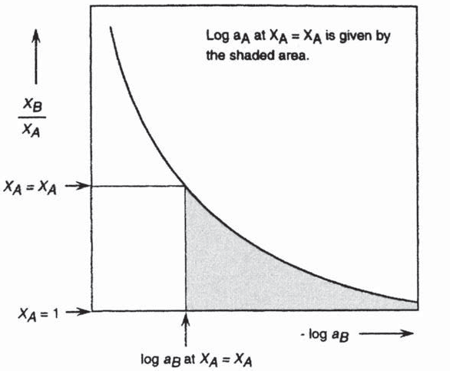
272 Introduction to the Thermodynamics of Materials
Thus
(9.52)
Therefore
Figure 9.12 A schematic representation of the variation of log a_{B} with X_{B}/X_{A} in a binary solution, and illustration of the application of the Gibbs-Duhem equation to calculation of the activity of component A.
or
(9.53)
Subtraction of Eq. (9.53) from Eq. (9.49) gives

Slide 8


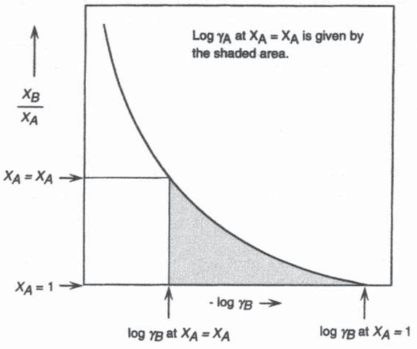
The Behavior of Solutions 273
or
(9.54)
Thus, if the variation of μ_{B} with composition is known, then integration of Eq. (9.54) gives the value of log μ_{A} at the composition X_{A}=X_{A} as
(9.55)
A typical variation of log μ_{B} with composition in a binary A–B solution is shown in Fig.
9.13. The value of log μ_{A} at X_{A}=X_{A} is given as the shaded area under the curve between the limits log μ_{B} at X_{A}=X_{A} and log μ_{B} at X_{A}=1.
Figure 9.13 A schematic representation of the variation of log μ_{B} with X_{B}/X_{A} in a binary solution, and illustration of the application of the Gibbs-Duhem equation to calculation of the activity coefficient of component A.

Slide 9





274 Introduction to the Thermodynamics of Materials
The a-Function
The second tail to infinity is eliminated by the introduction of the a-function, which for the component i is defined as
(9.56)
The a-function is always finite by virtue of the fact that μ_{i} → 1 as X_{i} → 1. For the components of a binary A–B solution
or
(9.57)
Differentiation of ln
gives
(9.58)
and substitution of Eq. (9.58) into Eq. (9.54) gives
(9.59)
Integration of Eq. (9.59) gives
(9.60)
By virtue of the identity

Slide 10

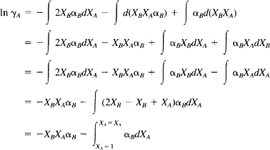
The Behavior of Solutions 275
the second integral on the right-hand side of Eq. (9.60) can be written as
substitution of which into Eq. (9.60) gives
(9.61)
Thus ln μ_{A} at X_{A}=X_{A} is obtained as –X_{B}X_{A}a_{B} minus the area under the plot of a_{B} vs. X_{A}
from X_{A}=X_{A} to X_{A}=1, and, as a_{B} is everywhere finite, the integration does not involve a
tail to infinity.
Fig. 9.8 shows the variation of a_{Ni} with composition in the system Fe-Ni at 1600°C as
measured by Zellars et al.,* and Fig. 9.10 shows the corresponding variation of μ_{Ni} with composition. Extrapolation of μ_{Ni} to X_{Ni}=0 in Fig. 9.10 gives the value of the Henry’s law
constant (k in Eq. (9.14)) as 0.66 for Ni in Fe at 1600°C. This, then, is the slope of the Henry’s law line for Ni in Fe drawn in Fig. 9.8. The variation of μ_{Fe} with composition,
shown in Fig. 9.10, is determined from consideration of either Fig. 9.14 or Fig 9.16.
Fig. 9.14 shows the variation of log with X_{Ni}/X_{Fe}, graphical integration of
^{μ}Ni
which, according t o Eq. (9.55), gives the variation of log μ_{Fe} with composition.
*G.R.Zellars, S.L.Payne, J.P.Morris, and R.L.Kipp, “The Activities of Iron and Nickel in Liquid Fe-Ni Alloys,” Trans. AIME (1959), vol. 215, p. 181.

Slide 11
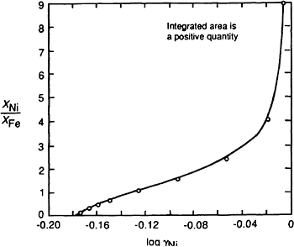
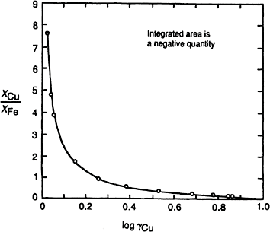
276 Introduction to the Thermodynamics of Materials
Figure 9.14 Application of the Gibbs-Duhem equation to determination of the activity of iron in the system iron-nickel.
Figure 9.15 Application of the Gibbs-Duhem equation to determination of the activity of iron in the system iron-copper.

Slide 12
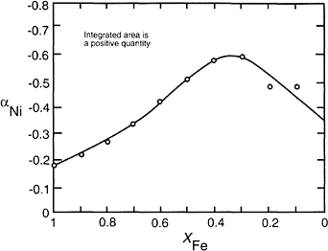
The Behavior of Solutions 277
Figure 9.16 The variation of a_{Ni} with composition in the system iron-nickel.
In the graphical integration, as log increases with increasing X_{Ni}/X_{Fe}, the
^{μ}Ni
integrated area under the curve between X_{Ni}=X_{Ni} and X_{Ni}=0 is a positive quantity.
Thus log μ_{Fe} is everywhere a negative quantity, and so Fe, like Ni, exhibits negative deviations from Raoult’s law. The variation of a_{Ni} with composition is shown in Fig.
9.16. As a_{Ni} is everywhere negative, the integrated area from X_{Fe}=X_{Fe} to X_{Fe}=1 is a positive quantity. Fig. 9.9 shows the variation of a_{Cu} with composition in the Fe-Cu
system at 1550°C measured by Morris and Zellars.* Fig. 9.11 shows the corresponding variation of μ_{Cu} with composition. Extrapolation of μ_{Cu} to X_{Cu}=0 gives k_{Cu}=10.1. Figures
9.15 and 9.17, respectively, show plots of log μ_{Cu} vs. X_{Cu}/X_{Fe} and a_{Cu} vs. X_{Fe}. As log μ_{Cu} decreases with increasing X_{Cu}/X_{Fe}, and a_{Cu} is everywhere positive, the integrated areas in both figures are negative quantities.
The Relationship between Henry’s and Raoult’s Laws
Henry’s law for the solute B in a binary A–B solution is
or, in terms of logarithms,
*J.P.Morris and G.R.Zellars, “Vapor Pressure of Liquid Copper and Activities in Liquid Fe-Cu Alloys,” Trans. AIME (1956). vol. 206, p. 1086.

Slide 13
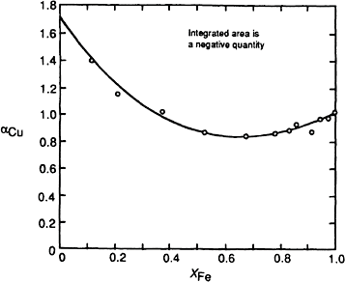

278 Introduction to the Thermodynamics of Materials
differentiation of which gives
Figure 9.17 The variation of a_{Cu} with composition in the system iron-copper.
Inserting this into the Gibbs-Duhem equation, Eq. (9.49), gives
Integration gives
or

Slide 14







The Behavior of Solutions 279
But, by definition, a_{i}=1 when X_{i}=1, and thus the integration constant equals unity.
Consequently, in the range of composition over which the solute B obeys Henry’s law, the solvent A obeys Raoult’s law.
Direct Calculation of the Integral Molar Gibbs Free Energy of Mixing
Eq. (11.33b) gave
Rearranging and dividing by
gives
or
Integrating between X_{A}=X_{A} and X_{A}=0 gives
(9.62)
and, as ln a_{A}, the integral molar Gibbs free energy of mixing of A and B can be obtained directly from the variation of a_{A} with composition as
(9.63)
The measured activities of Ni in Fe and Cu in Fe shown in Figs. 9.8 and 9.9 can be used to obtain
and

Slide 15
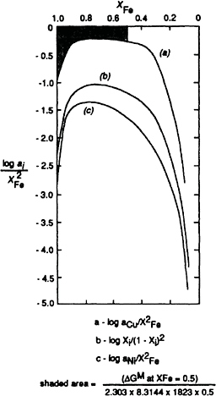
280 Introduction to the Thermodynamics of Materials
The graphical integrations of these equations are shown in Fig. 9.18, in which line (a) is vs. X_{Cu} and line (c) is vs. X_{Ni}. Line (b) shows the variation of
(ln X )/(1–X )² with X , which is the variation of the function for a component i which
i i i
exhibits Raoultian behavior. As is seen, some uncertainty is introduced into the
2
integration by virtue of the fact that the function (ln a_{i})/(1–X_{i}) → –œ as X_{i} → 0. In Fig
9.18 the shaded area (which is the value of the integral between X_{Cu} =0.5 and X_{Cu}=0),
multiplied by the factor 2.303×8.3144×1823×0.5, gives the value of OG^{M} at X =0.5.
Fe
Figure 9.18 Illustration of the direct calculation of the integral molar Gibbs free energies of mixing in the systems iron-copper at 1550°C and iron-nickel at 1600°C.

Slide 16



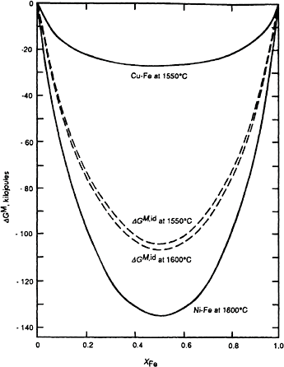
The Behavior of Solutions 281
The variations of OG^{M} obtained from the graphical integrations are shown in Fig. 9.19. Applied to a solution which exhibits Raoultian behavior (line b), the integration gives
OG^{M}
=
=
=
in agreement with Eq. (9.34).
The uncertainty caused by the infinite tail as X → 0 is eliminated if the equation is used
the calculate the excess Gibbs free energy (see Sec. 9.9). Eq. (9.62) is a general equation
Figure 9.19 The integral molar Gibbs free energies of mixing in the systems iron-copper at 1550°C and iron-nickel at 1600°C.

Slide 17



282 Introduction to the Thermodynamics of Materials
which relates the integral and partial molar values of any extensive thermodynamic function, e.g.,
(9.64)
and
(9.65)
9.9 REGULAR SOLUTIONS
Thus far two classes of solution have been identified:
Ideal or Raoultian solutions in which ln X_{i}
Nonideal solutions in which a_{i}ÇX_{i} and
–R
Attempts to classify nonideal solutions have involved the development of equations that describe the behavior of hypothetical solutions, and the simplest of these mathematical formalisms is that which generates what is known as “regular solution behavior.”
In 1895 Margules* suggested that, at constant temperature, the activity coefficients, μ_{A}
and μ_{B}, of the components of a binary solution could be represented by power series of the form
(9.66)
and, by application of the Gibbs-Duhem equation, namely,
(9.54)
he showed that if these equations are to hold over the entire range of composition of the solution, then a₁=ß₁=0. This is proved by obtaining both sides of Eq. (9.54) as power
series of X_{A} and X_{B} and equating the coefficients. By such comparison of the coefficients
of the power series, Margules further demonstrated that if the variations of the activity coefficients can be represented by the quadratic terms alone, then
(9.67)
*M.Margules “Über die Zusammensetzung der gesättigten Dampfe von Mischungen,”
Stizungsberichte. Akad. Wiss. Vienna (1895), vol. 104, p. 1243.

Slide 18


The Behavior of Solutions 283
In 1929 Hildebrand,† using an equation of van Laar‡ which is based upon the van der
Waals equation of state for mixtures, showed that if the value of the van der Waals “b” is the same for both components, then, in the binary A–B solution,
and
(9.68)
Hildebrand assigned the term “regular solution” to one obeying Eq. (9.68). Consideration of Eq. (9.61) shows that if the value of a for one component, say, component B, is independent of composition, then
But, as Eq. (9.57) gave ln
, it is seen that
From Eq. (9.68), a for a regular solution is an inverse function of temperature, i.e.,
(9.69)
† J.H.Hildebrand, “Solubility XII, Regular Solutions,” J. Am. Chem. Soc. (1929), vol. 51, p. 66.
‡J.J.van Laar, “The Vapor Pressure of Binary Mixtures,” Z. Physik. Chem. (1910), vol. 72, p. 723.

Slide 19
284 Introduction to the Thermodynamics of Materials
Hildebrand defined a regular solution as one in which
The properties of a regular solution are best examined by means of the concept of excess functions. The excess value of an extensive thermodynamic solution property is simply the difference between its actual value and the value that it would have if the solution were ideal, e.g., as applied to the Gibbs free energy of the solution.
(9.70)
where
G=the molar Gibbs free energy of the solution
G^{id}=the molar Gibbs free energy which the solution would have if it were ideal
G^{XS}=the excess molar Gibbs free energy of the solution
Subtraction of the Gibbs free energy of the unmixed components both sides of Eq. (9.70) gives
from
(9.71)
As for any solution,
and, for an ideal solution,
then
(9.72)
For a regular solution, OS^{M}=OS^{M,id}, and thus
(9.73)

Slide 20


The Behavior of Solutions 285
Now
and as
then
(9.74a)
(9.74b)
For a regular solution, ln (9.74a) gives
, and ln
, substitution of which into Eq.
(9.75)
or, from Eq (9.69), gives
(9.76)
It is thus seen that G^{XS} for a regular solution is independent of temperature. This can also been shown as follows:
and, as S^{XS} for a regular solution is zero, then G^{XS}, and hence OH^{M}, are independent of temperature. From Eqs. (9.74a), (9.74b), and (9.75), at any given composition,

Slide 21

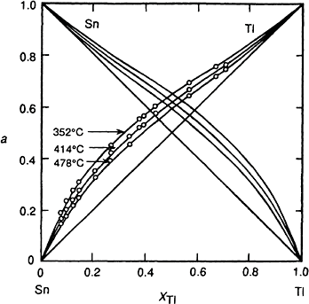
286 Introduction to the Thermodynamics of Materials
and hence, for a regular solution,
Eq. (9.77) is of considerable practical use in converting activity data for a regular solution at one temperature to activity data at another temperature.
Figs. 9.20 and 9.21, respectively, show the symmetrical variation, with composition, of the activities and activity coefficients in the system tin-thallium measured by Hildebrand and Sharma* at three temperatures, and Fig. 9.22 shows the linear variations of log μ_{T1}
Figure 9.20 Activities in the system thallium-tin. (From J.H.Hildebrand and
J.N. Sharma, “The Activities of Molten Alloys of Thallium with Tin and Lead,” J. Am. Chem. Soc. (1929), vol. 51, p. 462.)
*J.H.Hildebrand and J.N.Sharma, “The Activities of Molten Alloys of Thallium with Tin and Lead,” J. Am. Chem. Soc. (1929), vol. 51, p. 462.

Slide 22
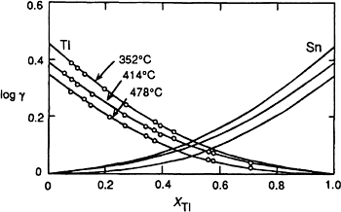
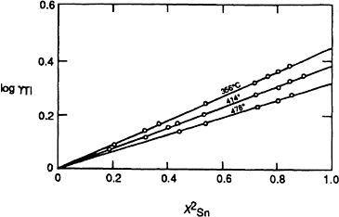
The Behavior of Solutions 287
Figure
9.21 Activities coefficients in the system thallium-tin. (From J.H.Hilde-brand and J.N.Sharma, “The Activities of Molten Alloys of Thallium with Tin and Lead,” J. Am. Chem Soc. (1929), vol. 51, p. 462.)
Figure 9.22 Log μ_{T1} vs. in the system thallium-tin. (From J.H.Hildebrand
and J.N.Sharma, “The Activities of Molten Alloys of Thallium with Tin and Lead,” J. Am. Chem. Soc (1929), vol. 51, p. 462.)
where, the slopes of which equal a at the given temperatures. The variation of
μ_{i} with X_{i} is that of a regular solution, but Fig. 9.23 shows that aT, which for strict adherence to regular behavior should be independent of T, decreases slowly with in- creasing temperature. Fig. 9.24 shows the variations, with composition, of OG^{M}, OH^{M},

Slide 23

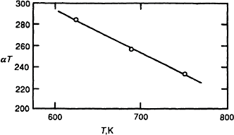
288 Introduction to the Thermodynamics of Materials
and –TOS^{M} for the system T1–Sn 414°C. It is to be noted that a parabolic form for OH^{M}, or G^{XS} should not be taken as being a demonstration that the solution is regular, as it is frequently found that G^{XS} or OH^{M} can be adequately expressed by means of the relations
where b and b′ are unequal, in which case from Eq. (9.72)
This type of behavior is found in melts in the system Au–Cu and Au–Ag. In the system Au-Cu at 1550 K, G^{XS}=–24,060 X X joules is parabolic, OH^{M} is asymmetric, and
Cu iAu
S^{XS}Ç0. Conversely, in the system Au–Ag at 1350 K, OH^{M}= –20,590 X X joules is
Ag Au
parabolic, G^{XS} is asymmetric, and S^{XS}Ç0.
The molar excess Gibbs free energy can be obtained from a knowledge of the dependence, on composition, of the activity coefficient of one component by means of Eq. (9.63), written as
XS
Thus, for a Raoultian solutions, as μ_{A}=1, G =0, and for a regular solution, as ln
.
Figure 9.23 The variation of the product aT with T in the system T1–Sn.

Slide 24
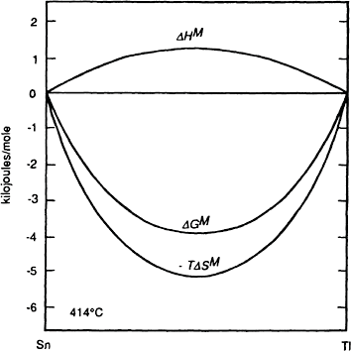

The Behavior of Solutions 289
Figure 9.24 The molar enthalpy, entropy, and Gibbs free energy of mixing of thallium and tin at 414°C.
9.10 A STATISTICAL MODEL OF SOLUTIONS
Regular solution behavior can be understood by application of the statistical mixing model, introduced in Chap. 4, to two components which have equal molar volumes and which do not exhibit a change in molar volume when mixed. In both the pure state and in solution the interatomic forces exist only between neighboring atoms, in which case the energy of the solution is the sum of the interatomic bond energies.
Consider 1 mole of a mixed crystal containing N_{A} atoms of A and N_{B} atoms of B such that
where N_{O} is Avogadro’s number. The mixed crystal, or solid solution, contains three types of atomic bond:
1. A–A bonds the energy of each of which is E_{AA}

